Slide 1

Bipartite Graphs
How does maximal optimisation for favours from two parties work?

Slide 2
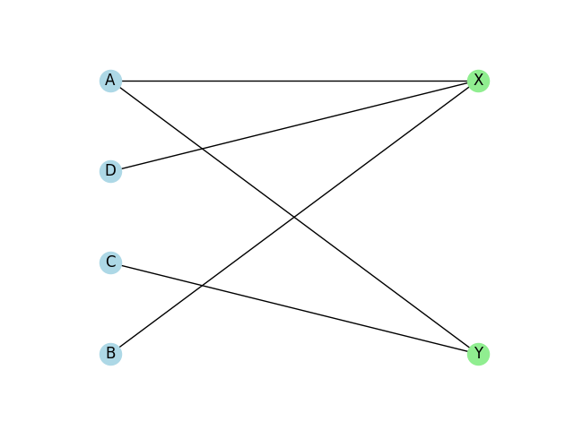
What Are Bipartite Graphs ?

Slide 3


Mathematical Representation.
Graph is Collection of Nodes and Edges
$$G=\left(V,E\right)$$
Where $V is set of nodes and E is set of edges.$
Bipartite Graphs have two set of Nodes such that There is no edge between any two node of one set.
Mathematically : $∃ V_{1},V_{2} st V_{1}∪V_{2}=V and V_{1}∩V_{2}=∅$
$$(G=(V_{1},V_{2},E))$$
Bipartite Graphs representation : $G=\left(V_{1},V_{2},E\right)$

Slide 4
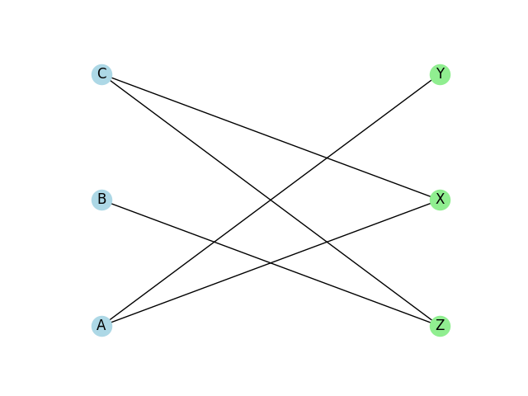
Visualisation
**Codes are also in submission

Slide 5
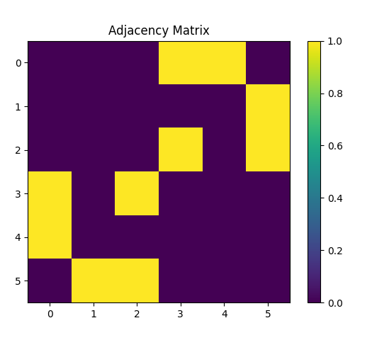
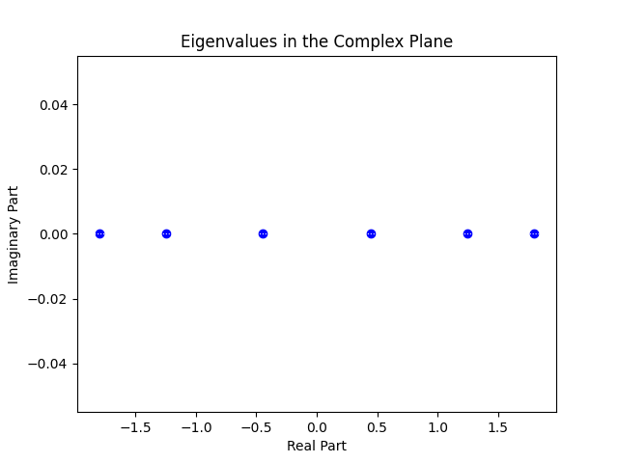
Adjoint Matrix , Graph and Eigen Plot

Slide 6
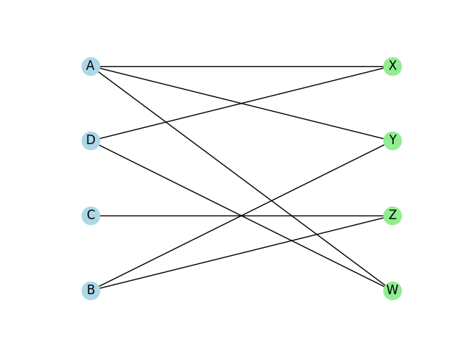
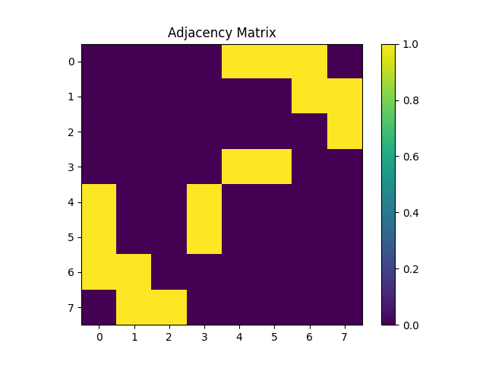
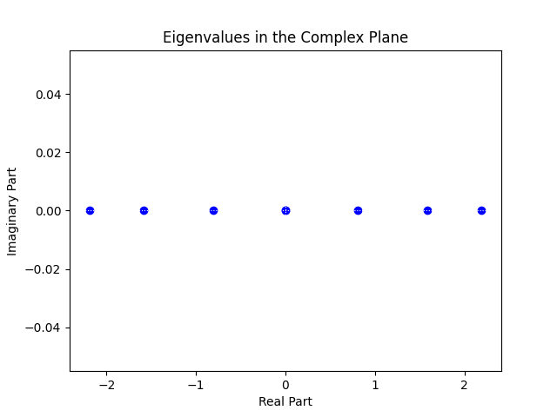
Adjoint Matrix , Graph and Eigen Plot

Slide 7
Applications
Matching and Assignment Problems :
Entries from one set need to be paired with another based on certain criteria
Bipartite Graphs model such problems and device efficient algorithms to find optimal solutions.
Applications of this include Resource Allocation, Job Assignment and project Scheduling.

Slide 8
Biological and Social Networks
Bipartite graphs find applications in analyzing biological networks, such as protein-protein interaction networks or gene-disease association networks.
Similarly, bipartite graphs are utilized in social network analysis to study interactions between individuals and groups, friendship networks, and information diffusion.

Slide 9

Relation with Eigenvalue and Proof

Slide 10
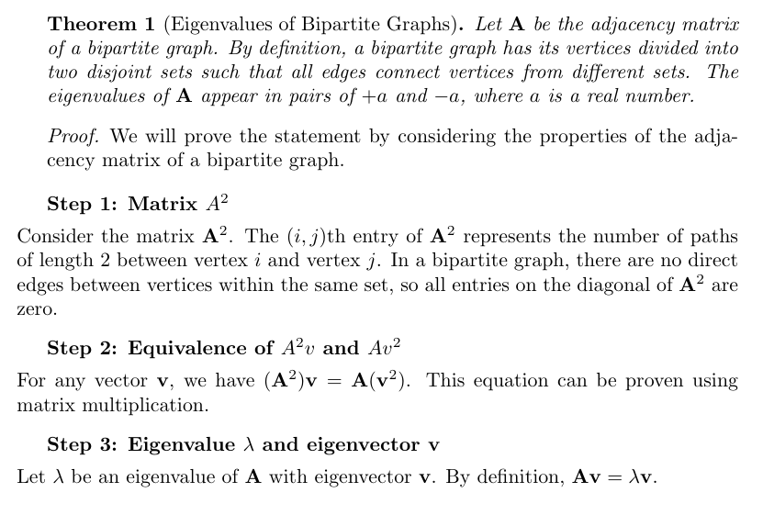

Slide 11
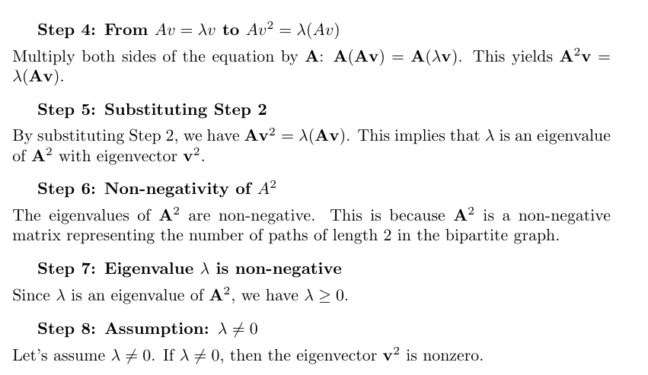

Slide 12
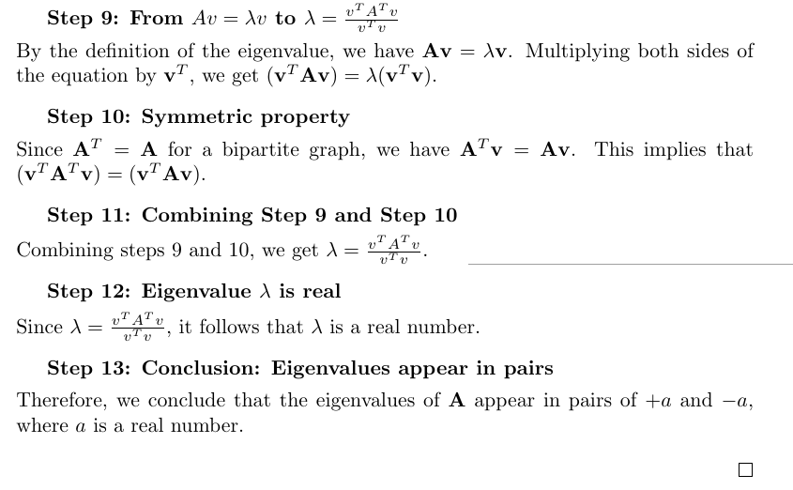

Slide 13
